Slide 1

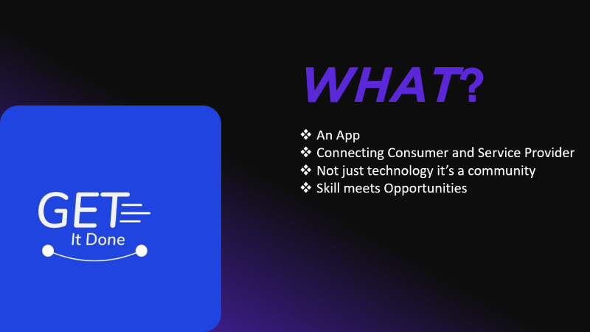
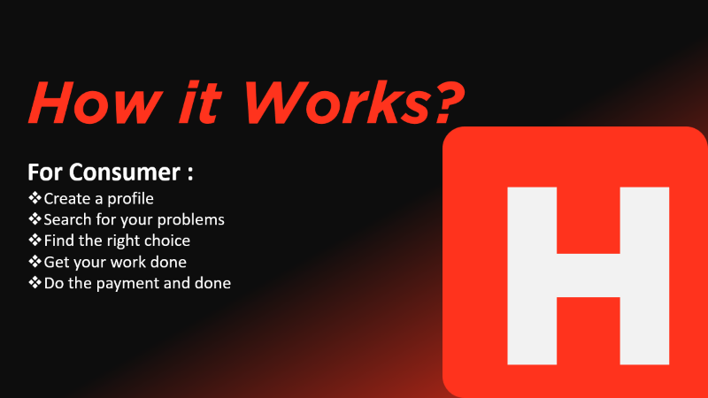


Slide 2

WHAT?
An App
Connecting Consumer and Service Provider
Not just technology it’s a community
Skill meets Opportunities

Slide 3
How it Works?
H
For Consumer :
Create a profile
Search for your problems
Find the right choice
Get your work done
Do the payment and done

Slide 4
W
Why Us?
Trust
Assurance
Transparency
Range of choices
Convenience

Slide 5
o
How it Works?
For Service Provider :
Create a profile
Showcase your skills
Get verified by experts
Get invite connects
Provide the service
Receive the payment and done

